Slide 1
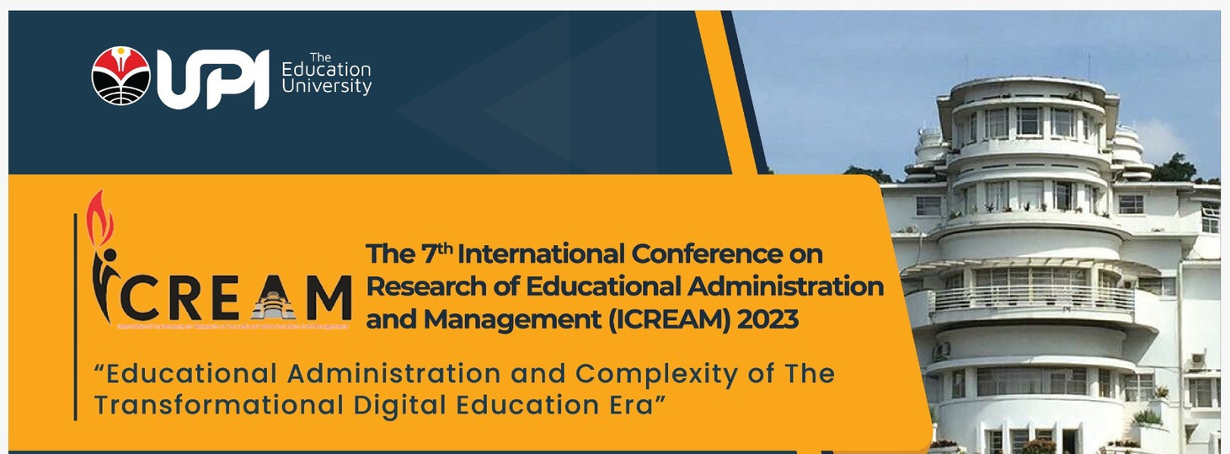
QUICKLY SOLVING STUDENT PROBLEMS: THE IMPLEMENTATION
OF SERVANT LEADERSHIP THROUGH THE STUDENT CHARACTER-BUILDING PROGRAM IN ELEMENTARY SCHOOL
Presented by
RD FURQON
School of Postgraduate, Educational Administration
Universitas Pendidikan Indonesia
Bandung, Indonesia

Slide 2

INTRODUCTION
WE KNOW THAT :
Education is a process of forming and fostering humans into individuals with character.
Develop a strong sense of character by adopting noble values.
The character has three interconnected parts:
moral knowledge, which includes moral awareness, knowledge of moral values, perspective determination, moral thinking, decision-making, and personal knowledge.
Moral feelings include conscience, self-esteem, empathy, loving good things, self-control, and humility.
Moral action has three character aspects: competence, desire, and habits.
A school is an institution that has programs to achieve educational goals.
Taken from the Minister of Education Decree (2010: 9), values in character education are religion, honesty, tolerance, discipline, hard work, creativity, independence, democratic, curiosity, national enthusiasm, love for the country, respect for achievement, friendliness /communicative, peace of mind, love of reading, caring for the environment, social care, responsibility.
Teachers have an essential role in educating the nation's youth. According to research (Arifudin et al., 2022), teachers need to possess several important qualities, including being faithful, having noble character, being wise, democratic, steady, mature, authoritative, honest, sporting, being a role model for students, self-evaluative, and committed to personal development. Teachers aim to help students become good citizens and contribute positively to society.
THE GAP
However, some students exhibit negative behavior, such as bullying, sexual violence, and intolerance. The Minister of Education, Nadiem Makarim, has identified these as the three major problems in education (Pendidikan & Dan, 2023). Based on data released by Bankdata.kpai.go.id (2021) in (Pendidikan & Dan, 2023), there were 24,974 cases of child protection issues in Indonesia, and 3,194 of these cases were related to schools. In addition, some students may feel they need to be more energized, active, or unenthusiastic about learning. Schools may also need to be faster to address student problems.

Slide 3

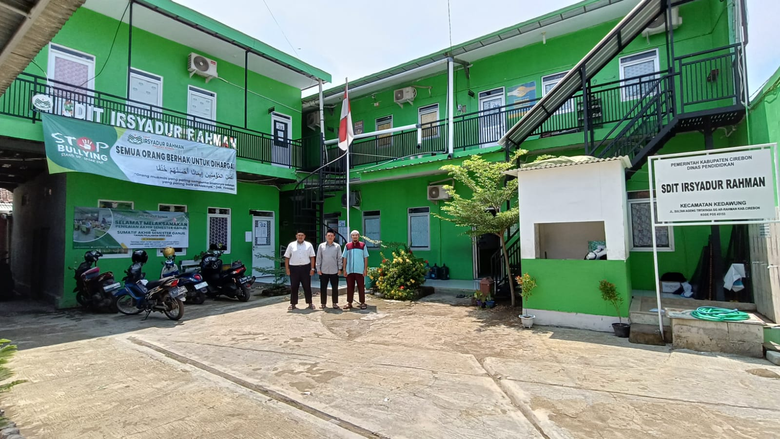
Fill The Gap by
RESEARCH
#To Know
This research is important because this increasingly dynamic and complex life requires schools and teachers to restore the true functioning of schools. This study aims to solve school student problems, such as bullying, sexual violence, intolerance, and lazy classroom learning, by implementing a teacher's servant leadership approach through a student character-building program at SDIT Irsyadur Rahman, Kabupaten Cirebon.
Implementation of Servant Leadership in Student Character Building Program: Teachers as Leaders
#How to
Solving Student Problems Quickly Through the Student Character Building Program at SDIT Irsyadur Rahman
#Recomendation
How the program can be implemented in all school institutions

Slide 4

METHOD
Qualitative Descriptive
TECHNIQUE
INSTRUMENT
PROCEDURE ANALYSIS
Observation
Interview
The Participant:
Candra Alexander is a Principal and Teacher
Mujaddid is a Teacher
Documentation
Using :
Record and take a picture use handphone
Procedure Analysis of this data using triangulation

Slide 5
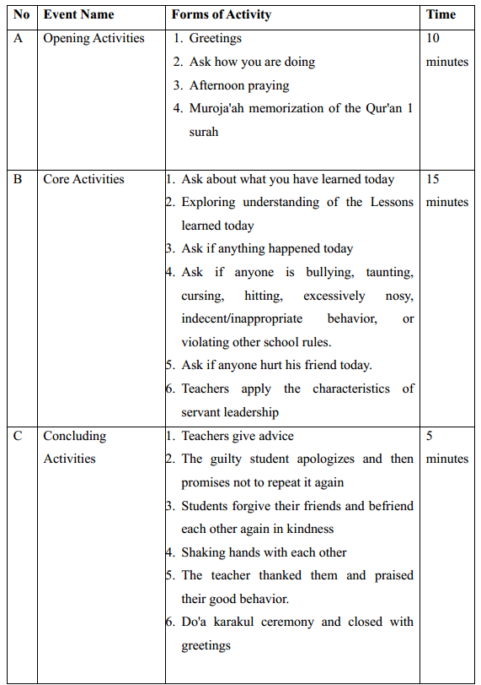
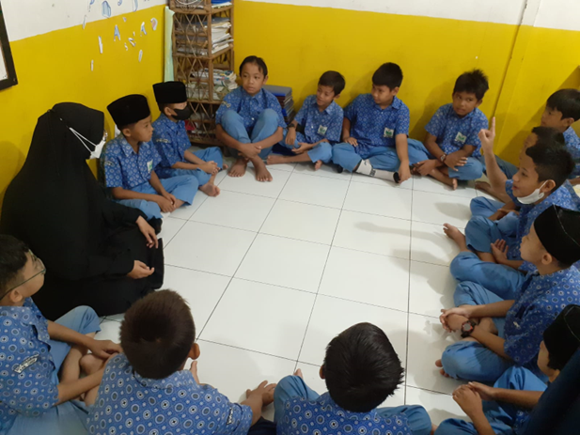
RESULT 1
Implementation of Servant Leadership in Student Character Building Program: Teachers as Leaders
According to (Retno et al., 2020), Leadership is conferred upon a person who is naturally a servant (Valeri, 2007).
Leaders are expected to have qualities and skills in listening, empathy, healing, awareness, persuasion, conceptualization, foresight, stewardship, commitment to people’s growth, and building community, this idea is further reinforced by Spears (1995).
"So at SDIT Irsyadur Rahman school, we give direction and also regularly to students, because we are full day from 7 o'clock to 4 o'clock in between the time after finishing the asar prayer, our students here are made into small groups, where each group has a name for its mentor. The purpose of this advisor is to provide direction and also find out what happened during this one day to the student or group."
(Candra Alexander)

Slide 6
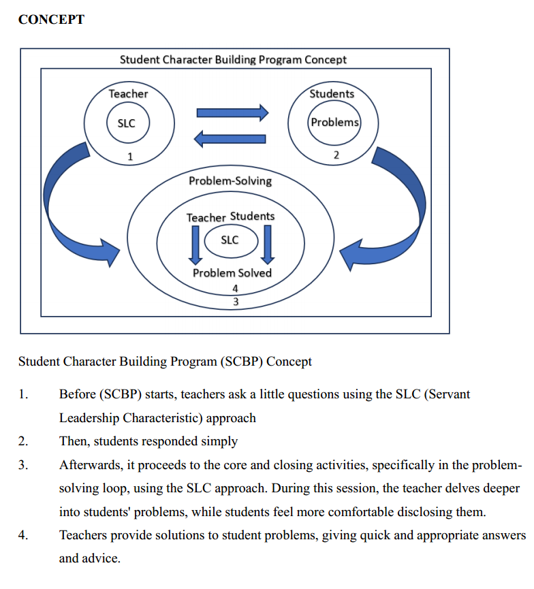

CONCEPT
Student Character Building Program
Ten characteristics of servant leadership (Spears, 1995):
1. Listening: Servant leaders listen attentively to others, identify and help clarify the wishes of the group, as well as listen to their inner voice;
2. Empathy: Servant leaders are those who seek to understand colleagues and are able to empathize with others;
3. Healing (healing): Servant leaders are able to create emotional healing and connection with themselves or relationships with others because relationships are a force for transformation and integration;
4. Awareness: Awareness to understand issues involving ethics, power, and values. View the situation from a balanced position that is more integrated;
5. Persuasion (persuasion): Servant leaders seek to convince others rather than force obedience. This is one of the most distinguishing things between traditional authoritarian models and servant leadership;
6. Conceptualization: The ability to see problems from a conceptualization perspective means thinking long-term or visionary on a broader basis;
7. Foresight: Observant or meticulous in understanding lessons from the past, current realities, and possible consequences of decisions for the future;
8. Stewardship: Emphasize openness and persuasion to build trust from others;
9. Commitment to the growth of people: Responsibility for making efforts to improve the professional growth of employees and the organization;
10. Building Community : Identify ways to build community.

Slide 7
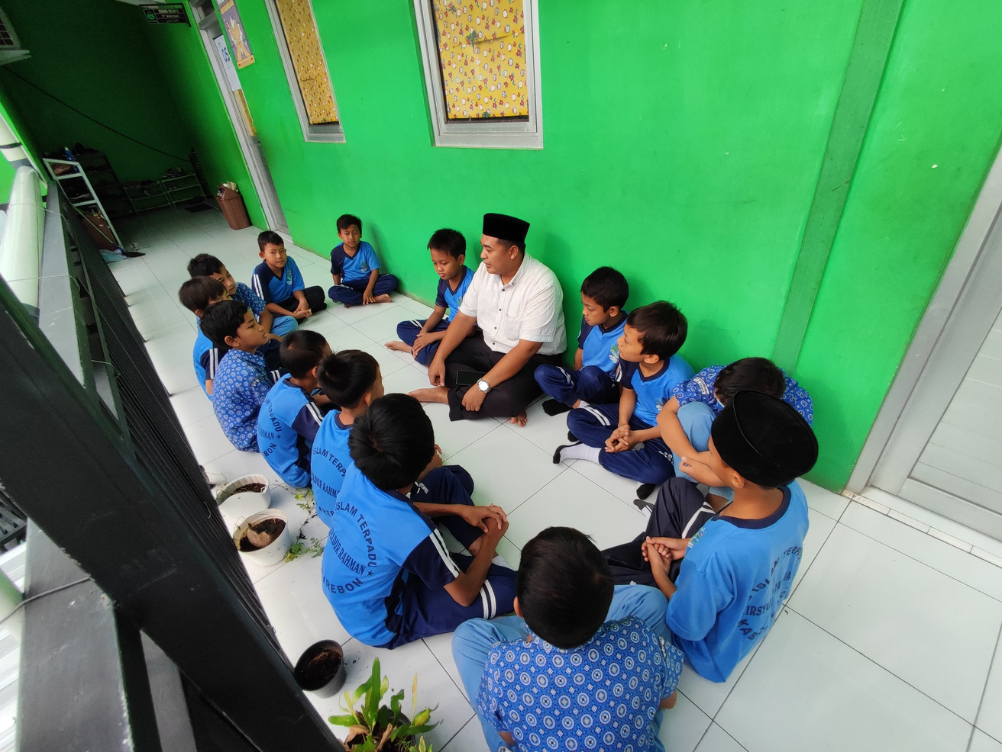
RESULT 2
Solving Student Problems Quickly Through the Student Character Building Program at SDIT Irsyadur Rahman
"The cases that occur are mostly about mocking each other. Because I happened to hold a group in grade 4, there were often cases of mocking each other when I asked what happened to this; this mocked me like that, and thank God for the program; with the program that we have run, this problem did not reach home. So we finish here, sir, according to the procedure: by giving advice first to those who mock him, we give good advice, try and remind adabs, especially about Adab Adab making friends, because they need to be reminded, sir." (Mujaddid)
Characteristics of Servant Leadership
Listening, empathy, healing, awareness, persuasion, conceptualization, foresight, stewardship, commitment to people’s growth, and building community (Spears, 1995).

Slide 8
DISCUSSION
Researcher will begin by analyzing the participants' statements, namely Mr. Candra, the principal, and Mr. Mujaddid, the teacher, followed by the data from the concept and Table 1.
The program's purpose is to answer student problems. Enables teachers and students to interact, communicate, explore information, listen, and share information about students' activities in school during a full day (full-day school).
Opening Activities
Core Activities
Concluding Activities
This is done to establish familiarity between the students and teachers.
The aim is to calm the students' hearts and minds to be more open, honest, and receptive during the core activity session
This shows that the teacher wants to hear the students' complaints and appreciate their enthusiasm.
The teacher uses a servant leadership approach and brings a sense of empathy to the students' problems. The teacher encourages the students to be honest and open and to provide healing for their problems.
The concluding activity session involves the teacher providing advice and information about civility, mutual respect, and forgiveness. The teacher encourages the students to apologize to anyone they may have hurt and to promise not to repeat the mistake. The students who have been injured are encouraged to forgive their friends.
Differentiation
Differentiation

Slide 9
CONCLUSION
At SDIT Irsyadur Rahman, teachers have incorporated Servant Leadership values into their Student Character Building Program. This was demonstrated when they provided quick and appropriate solutions to student problems during an introduction session.
The program has three main benefits:
1. it serves as a preventive measure
2. it helps solve problems
3. it includes planned follow-up actions.
I have conducted a series of studies in the program with some limitations. One of the main limitations is insufficient time, which limits the depth of the research. Additionally, the studies were quite general, making it challenging for some introverted students who find it difficult to open up in public. In the future, I plan to explore these limitations and find solutions to overcome them. I also encourage readers to research this topic further and provide solutions.

