Slide 1
Implementation of a Website-Based Laboratory Information System to Improve the Effectiveness of Laboratory Management at Brigjend Katamso II Medan High School
The 7th International Conference on Research of
Educational Administration and Management (ICREAM) 2023
Presented by
Winda Sihotang
Universitas Negeri Medan

Slide 2
Introduction
Nothing Schedule
No information on the availability of tools and materials.
No Reporting
Conventional System
Laboratory of SMA Brigjend Katamso II Medan
Potential
DIGITALIZATION
School Accreditation with an A label
A proficient Science teacher in IT
The strategic school location
Stable internet connection
"Web-Based Laboratory Information System"

Slide 3
Relevant Research
Kuncoro, et al (2018)
Ferdian (2019)
Aryani, et al (2020)
Sinaga & Kom (2018)
Helping process scheduling data, user data, and teacher data, as well as providing practical activity information to students quickly and accurately.
The web-based information system assists in service-related aspects such as equipment borrowing and return, as well as generating routine daily, monthly, and annual reports.
The use of information systems can facilitate laboratory management in monitoring the maintenance of equipment and materials as well as support paperless programs.
Facilitating the performance of staff and lab heads in inputting user data for the lab, reporting practical activities, describing the condition and availability of items, as well as controlling and maintaining the laboratory.

Slide 4
METHOD
01
02
03
Quantitative method, utilizing the one group pretest-posttest experimental design
The subject of this research is determined using nonprobability sampling techniques.
The research subjects consist of seven science teachers (Chemistry, Physics, and Biology) teaching at Brigjend Katamso II High School in Medan.
Test
Conducted
Tests conducted: normality test, paired t-test hypothesis test, and N-Gain Score test

Slide 5
Criteria Index of N-gain Effectiveness Percentage
Percentage (%) N-Gain | Criteria
< 40 | Ineffective
40 – 55 | Less effective
56 – 75 | Moderately effective
> 76 | Effective

Slide 6
Result and Discussion

Slide 7
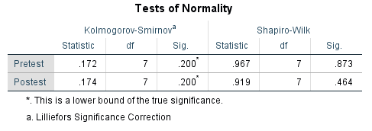
Limited Field Test
Average | Pretest | 30.45
 | Posttest | 83.27
 | N-Gain Score | 0.76
 | Category | High
 | Percent N-Gain | 76%
 | Criteria | Effective
Percent N-Gain Max |  | 83.64
Percent N-Gain Min |  | 68.63

Slide 8
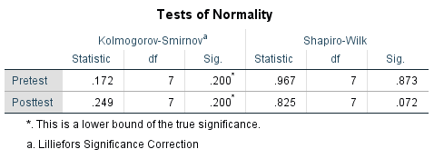
Wide Field Test
Average | Pretest | 30.45
 | Posttest | 94.92
 | N-Gain Score | 0.93
 | Category | High
 | Percent N-Gain | 93%
 | Criteria | Effective
Percent N-Gain Max |  | 100
Percent N-Gain Min |  | 88.46

Slide 10
CONCLUSION
Based on the N-Gain Score data from the limited field test, it was 76% with effective criteria, and the N-Gain Score from the extensive field test was 93% with effective criteria. This proves that the use of website-based information systems can enhance laboratory management.

Slide 11
Thank You

